Slide 1

Hackers with a Purpose: The Inside Story of Offensive Security Team
Oleksandr Kazymyrov
22.09.2023
Generated by DALL·E2

Slide 2




Agenda
Storebrand
Concepts
Offensive security
Real-life stories

Slide 3


Slide 4
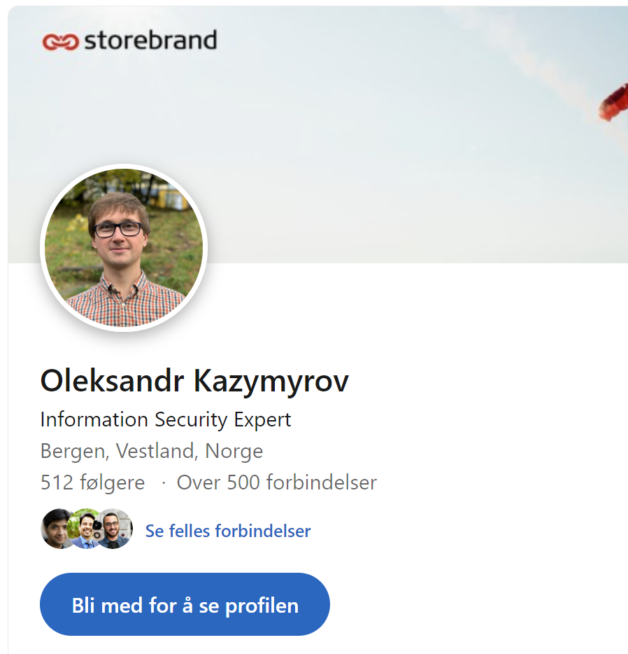


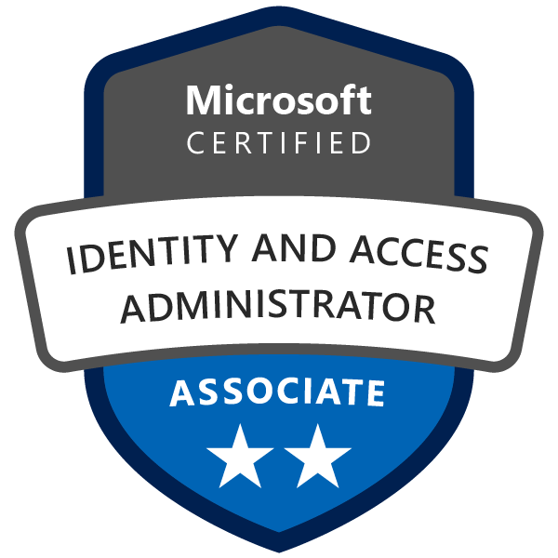








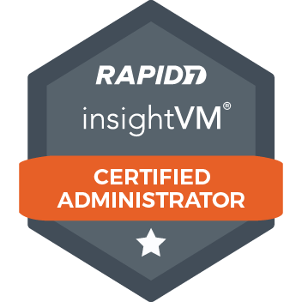

Who am I?

Slide 5
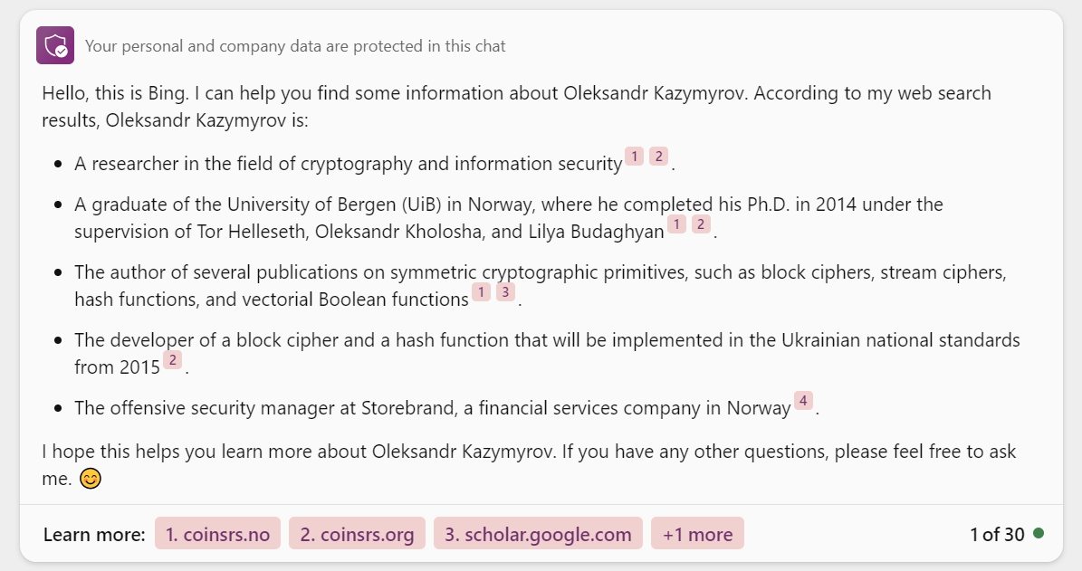
What does Bing know about Oleksandr Kazymyrov?

Slide 6
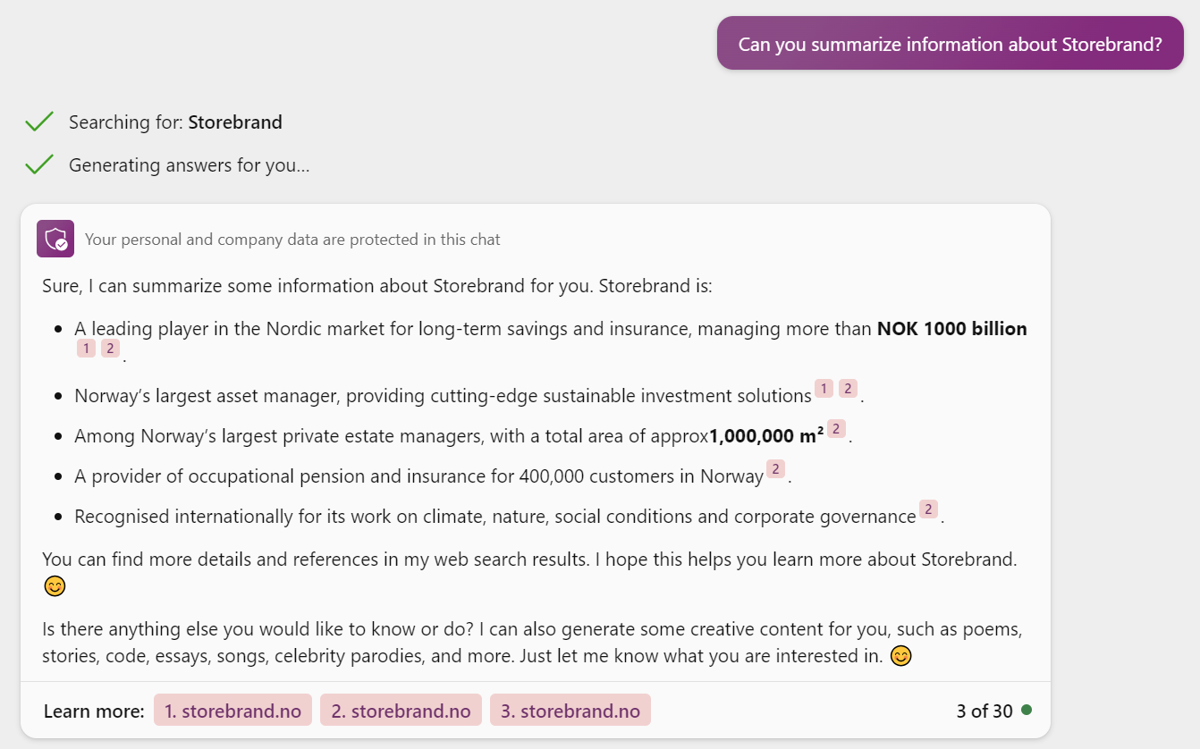
What about Storebrand?

Slide 7





Storebrand
Antall ansatte
~2200
Fossil-free funds
NOK billion
449
Funds for management NOK billion 1 020
Dow Jones Sustainability index
88/99

Slide 8
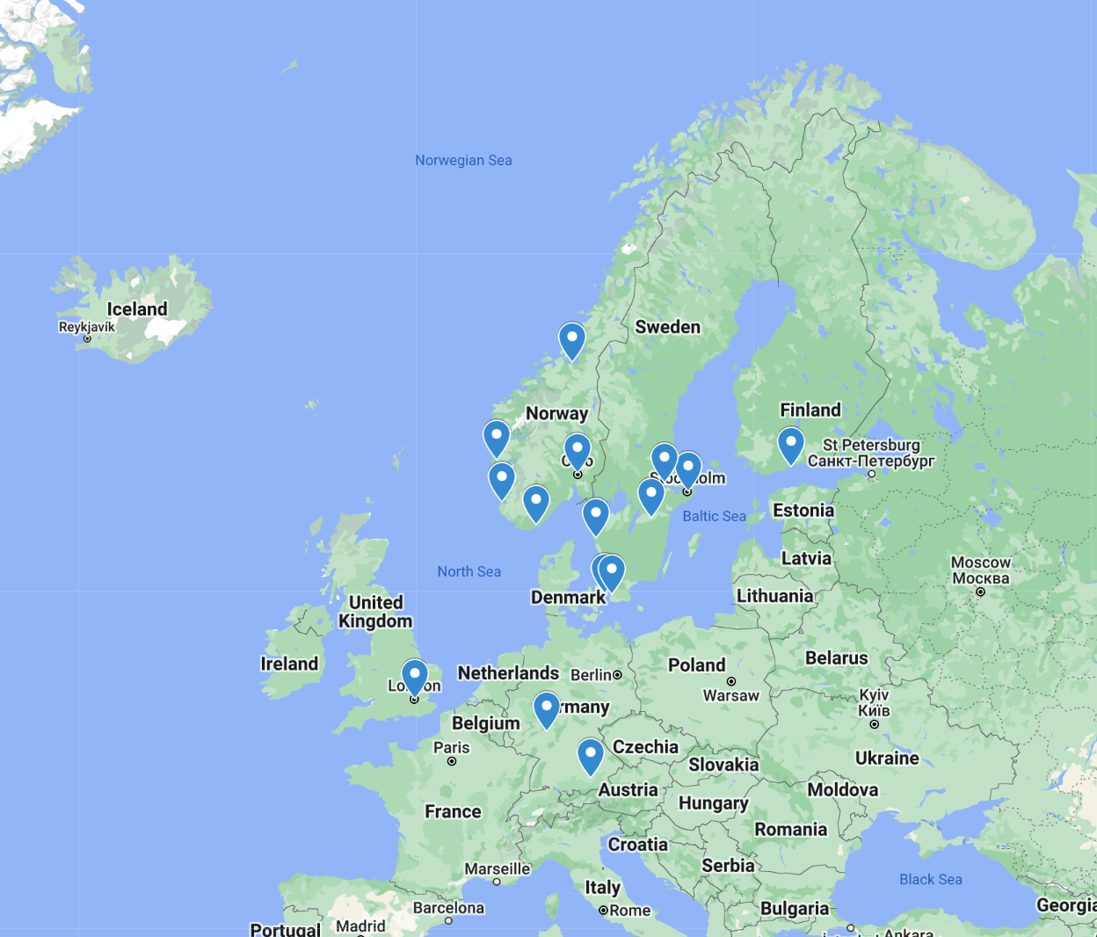

Storebrand Offices

Slide 9


Slide 10
Red Team
Blue Team
Yellow Team
Offensive security
Ethical hacking
Social engineering
Web app assessment
Defensive security
Infrastructure protection
Incident response
Threat hunting
Software developers
Application developers
Software engineers
System engineers

Slide 11
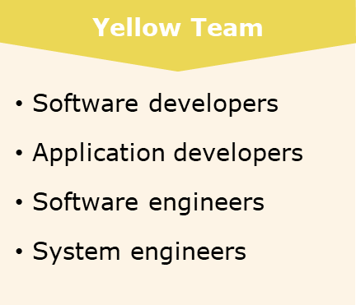
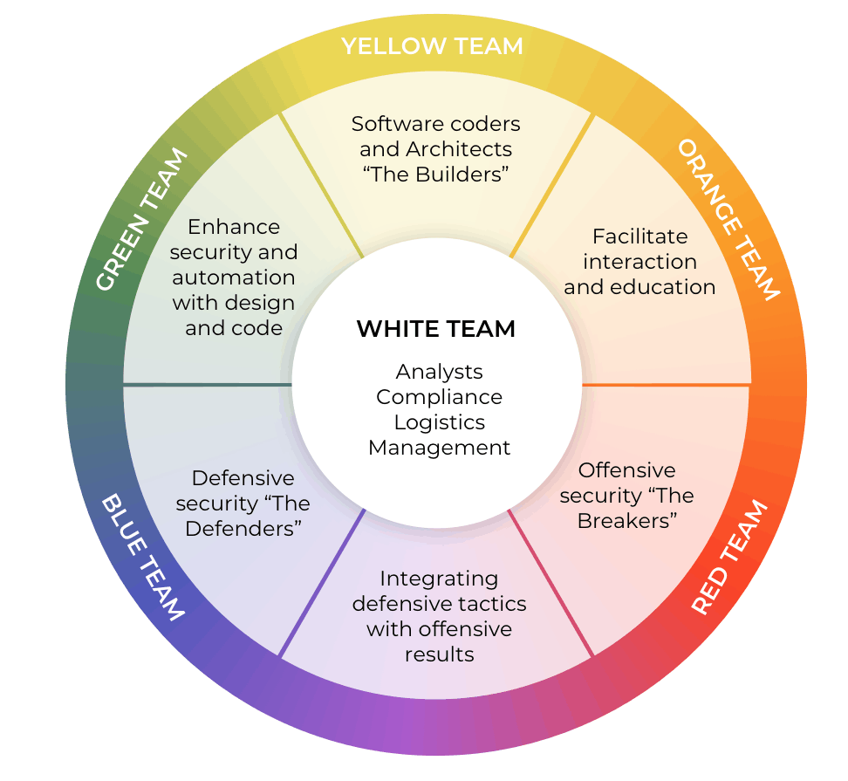
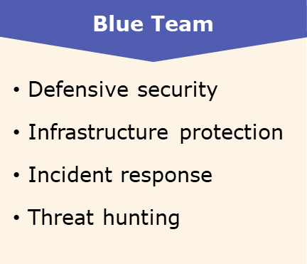
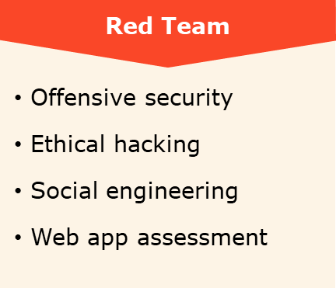
Infosec Color Wheel
PURPLE TEAM
Source: Infosec Color Wheel & The Difference Between Red & Blue Teams / Horangi CISO-as-a-Service

Slide 12
Penetration testing vs red teaming
PENETRATION TESTING
RED TEAMING
Time window for testing is brief
Testers use commercial petest tools
Employees are aware that testing is taking place
Testers seek to exploit known vulnerabilities
Test targets are predefined
Systems are tested independently
Time window for testing is extended
Team is encouraged to think creatively and use anything at hand for testing
Employees are usually not aware that testing is taking place
Testers seek to discover new vulnerabilities
Test targets are fluid and cross multiple domains
Systems are tested simultaneously

Slide 13
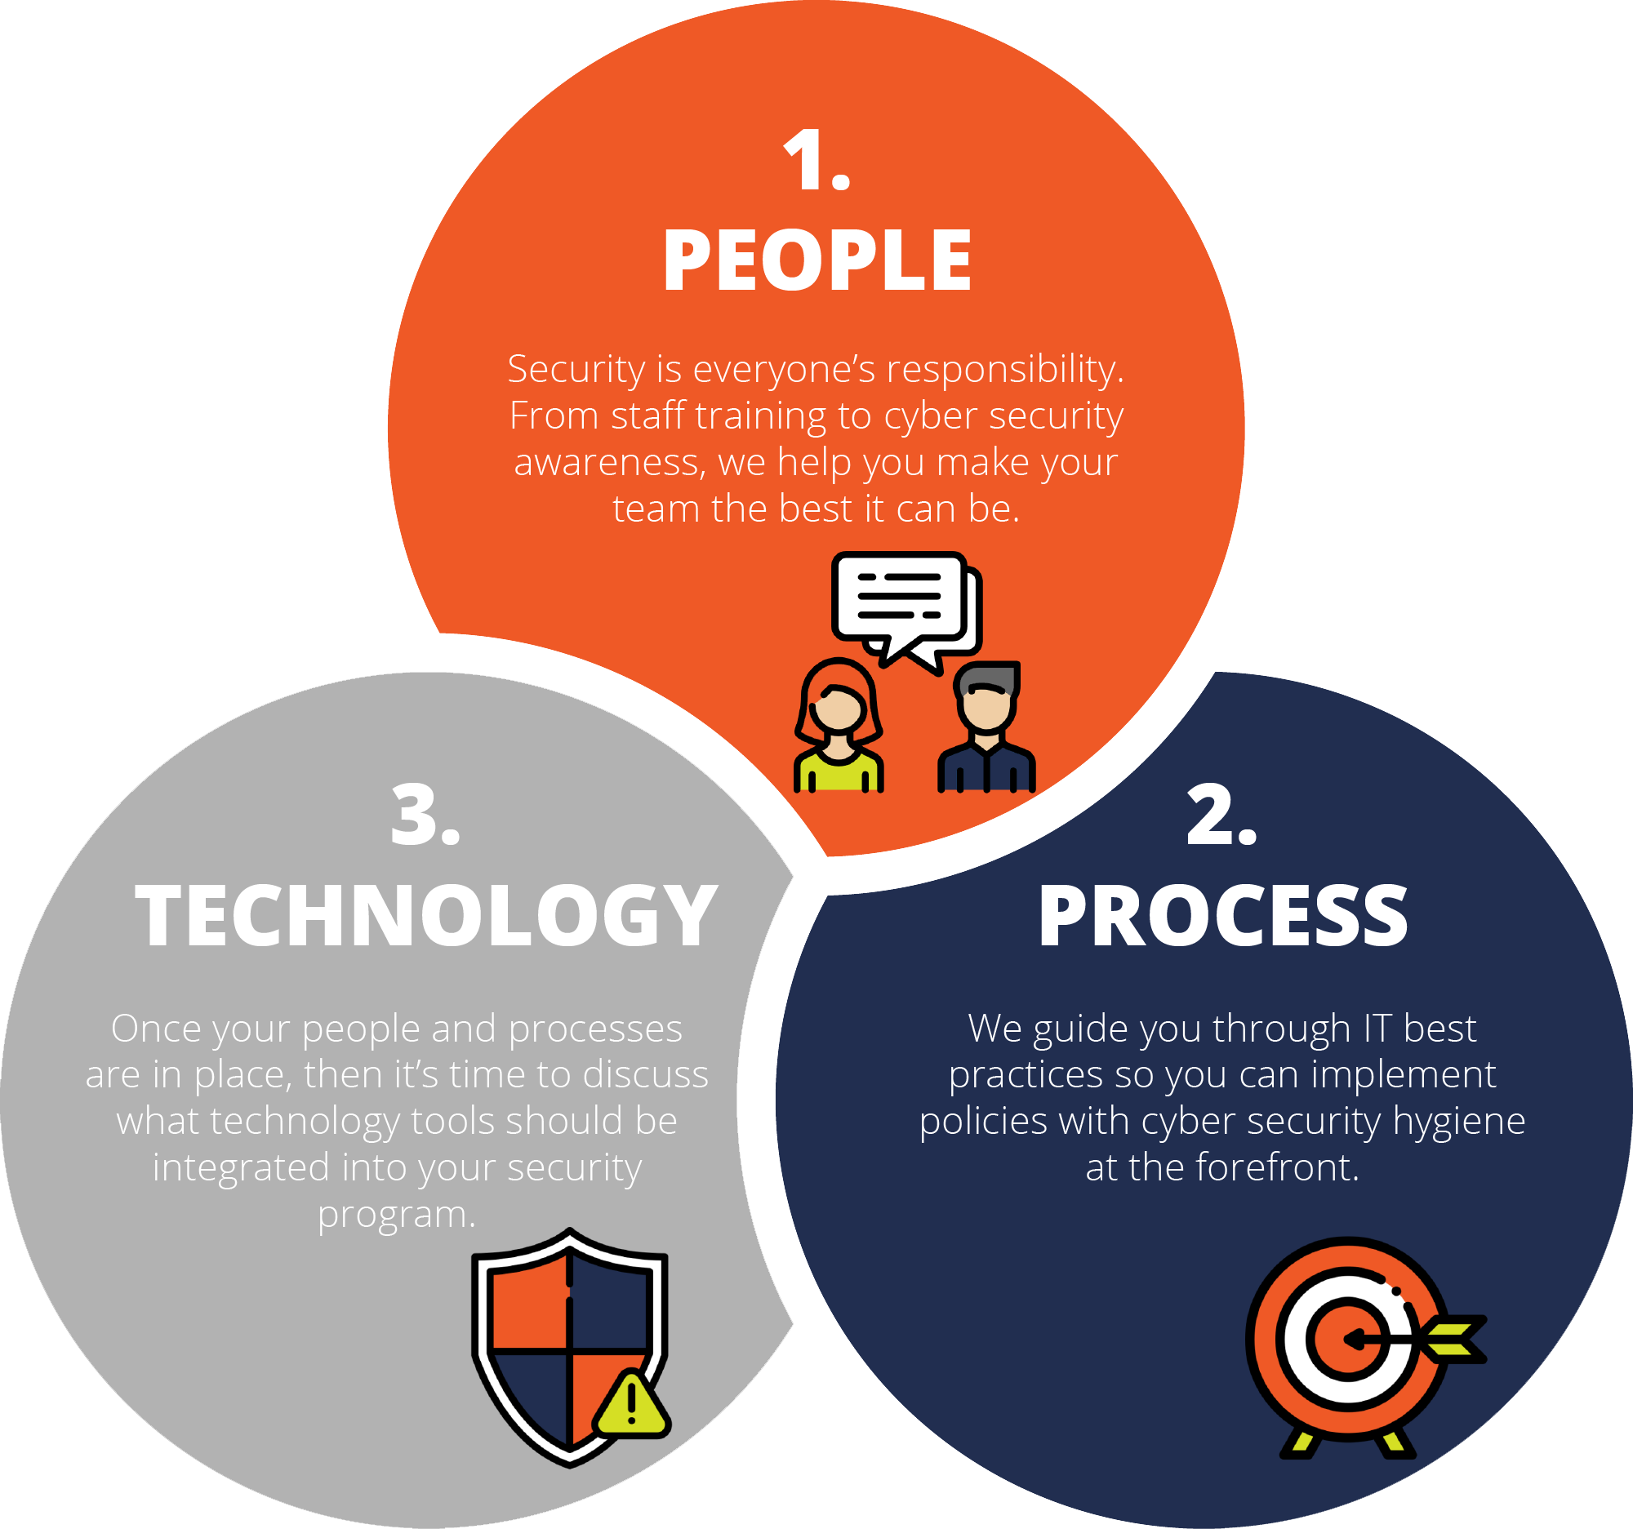
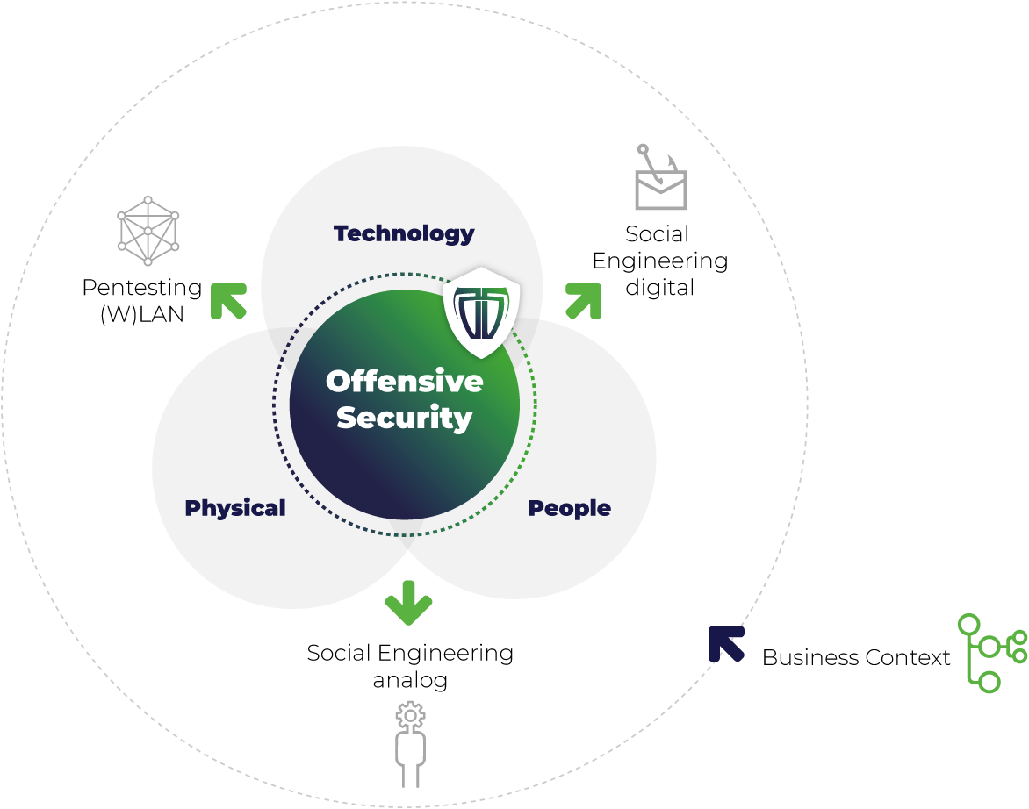
Offensive Security: People, Process and Technology
Source: The ADKtechs approach to cyber security / What is a pen test and how do we perform it?

Slide 14



Human risk
Phishing
Password
Information mishandling
Links, attachments and social manipulation
Social media is used to harvest information
Often the start of a larger attack, such as Ransomware
Weak passwords
Password reuse
Password storage
Password sharing
Information shared with a wrong recipient
Use of unauthorized services and devices
Mistakes can happen – people take shortcuts

Slide 15







Threat scenarios in the cloud
1. A hacker sends an attachment containing malware to one of the insurance agents/partners.
3.b
2
1. A hacker offers a deal to an agent who cannot refuse.
3.b The hacker may choose to install a backdoor on the AVD and get a separate session.
2. The hacker with the help of the insider threat/agent deploy malware on AVD or obtain a legitimate session.
2
1
1
3.a
2
3.a When the insurance partner accesses the AVD, the hacker hijacks/steal the session.
2. An insurance partner opens the attachment, and the malware connects back to the hacker. The hacker now have control of the laptop insurance partners laptop.
Phishing
Insider threat

Slide 16
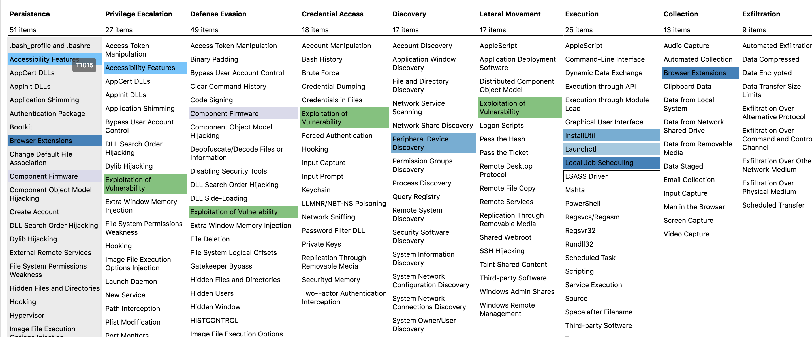
MITRE ATT&CK: Adversarial Tactics, Techniques and Common Knowledge
Source: https://attack.mitre.org/

Slide 17



Ransomware scenario
A user clicks on a phishing link/attachment
Exploitation
Files and data are exfiltrated to the threat actor IT environment
Extortion
2
4
Phishing
Exploitation of security vulnerabilities to find sensitive information
3
1
Extortion in the form of ransom
Exfiltration
Notes:
skaffer seg tilgang til en ansatts brukerkonto gjennom phishing
stjeler sensitiv kundedata fra åpne filområder og kryptere dataen.
truer med å publisere på internett mot løsepengesum
føre til operasjonell nedetid

Slide 18

Generate image: "a robot cat on a futuristic cyberpunk background"
Created by Bing image creator

Slide 19


Slide 20
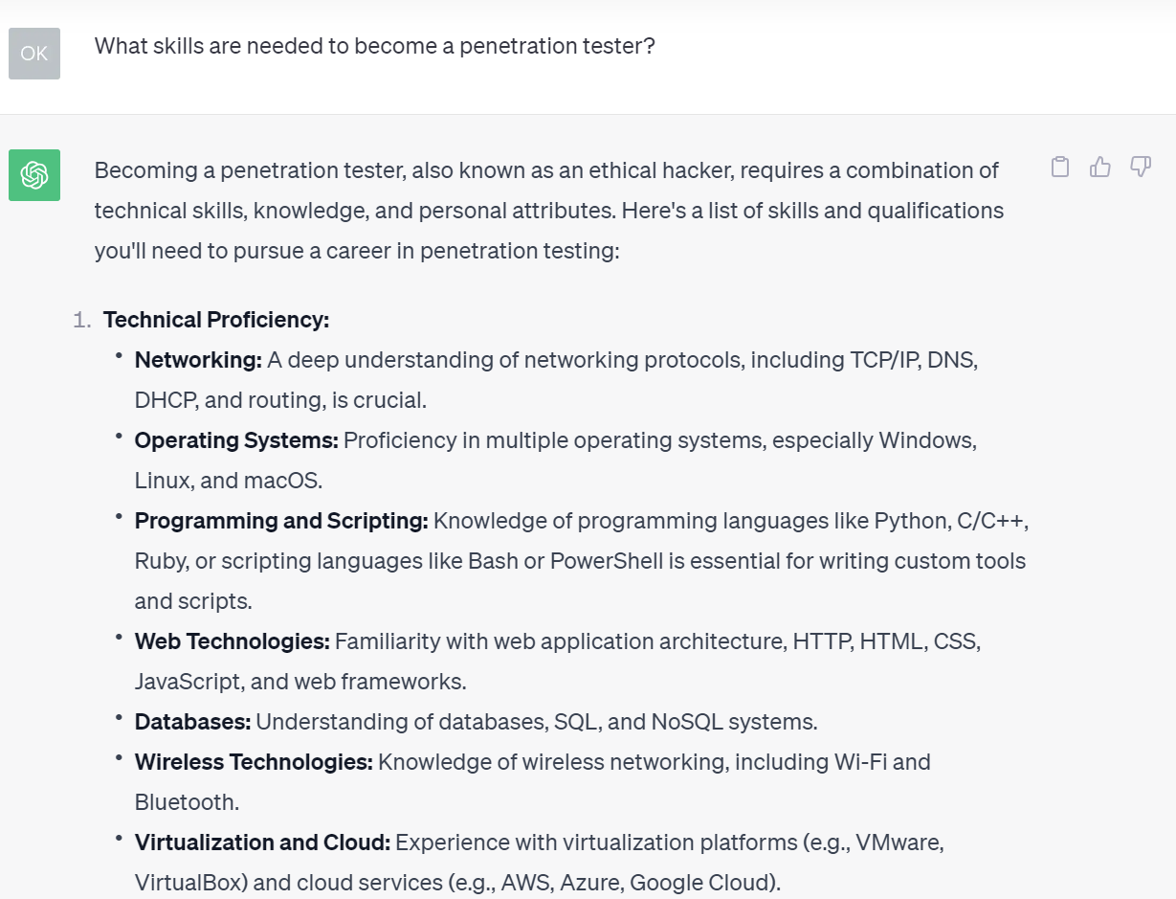
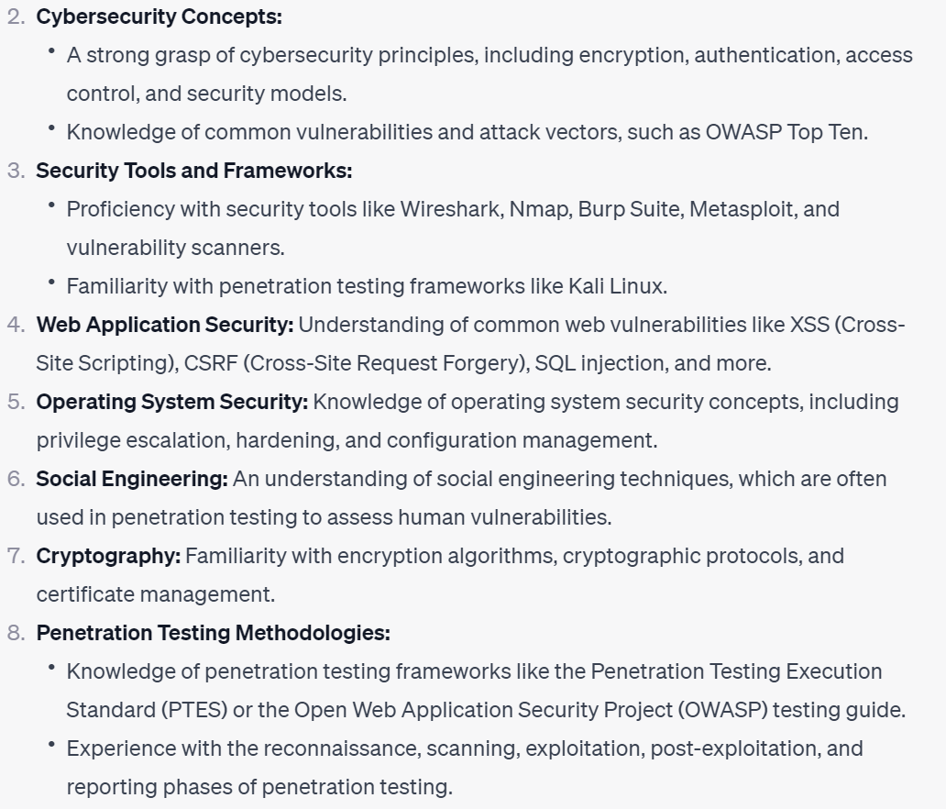
What skills are needed to become a penetration tester?

Slide 21
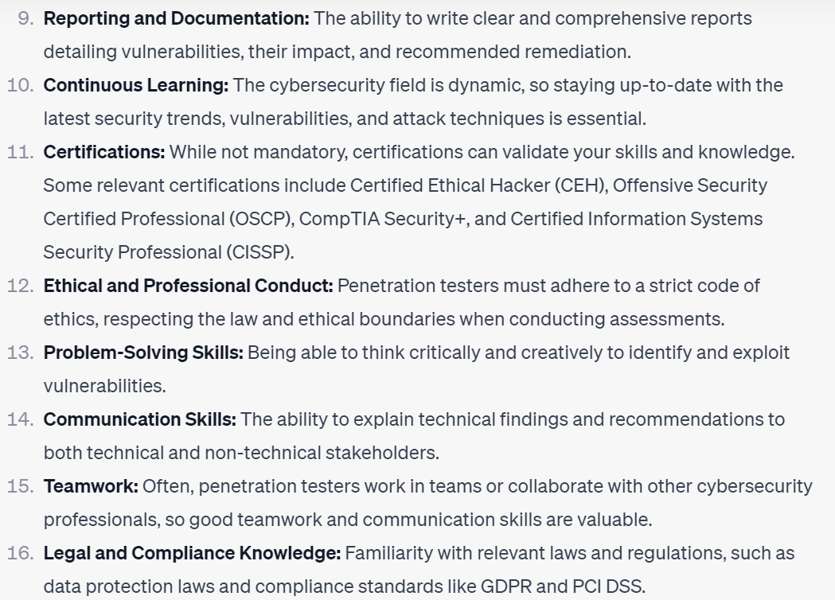
What skills are needed to become a penetration tester?
"It's important to note that penetration testing is a career that requires continuous learning and adaptation as new technologies and threats emerge."

Slide 22
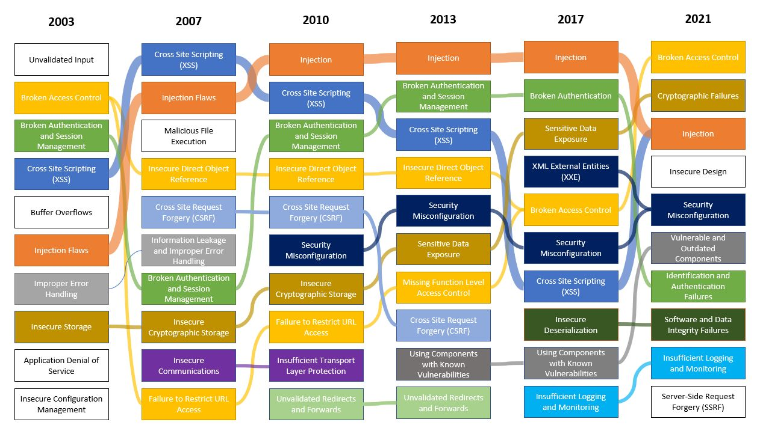
Evolution of the OWASP Top 10
Source: QakBot technical analysis (2021)

Slide 23



Mimicking real-world threat actors
Source: Dark Web Profile: Killnet – Russian Hacktivist Group / Analysis of the Russian-Speaking Threat Actor NoName 057(16) / Visualizing QakBot Infrastructure

Slide 24
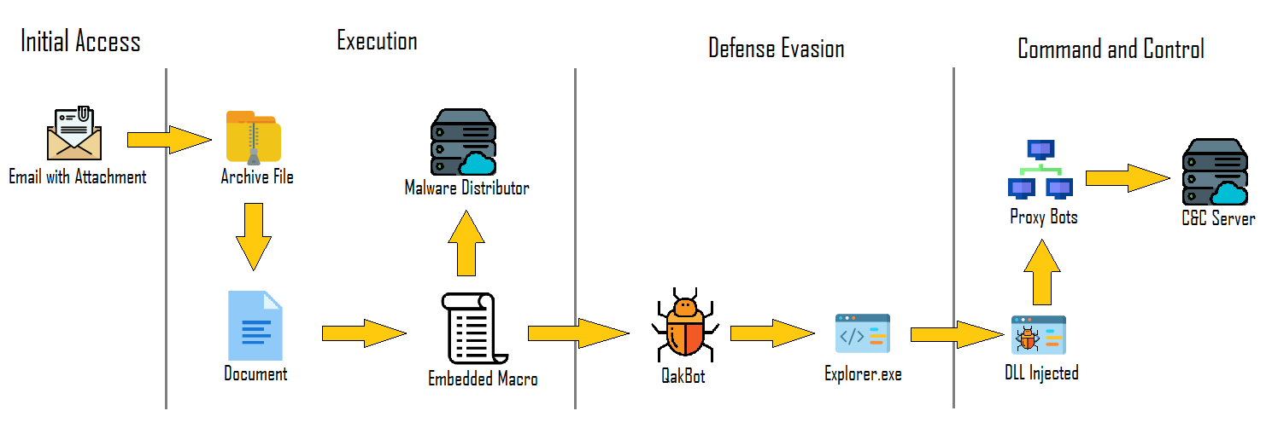
QakBot infection chain
Source: QakBot technical analysis (2021)

Slide 25
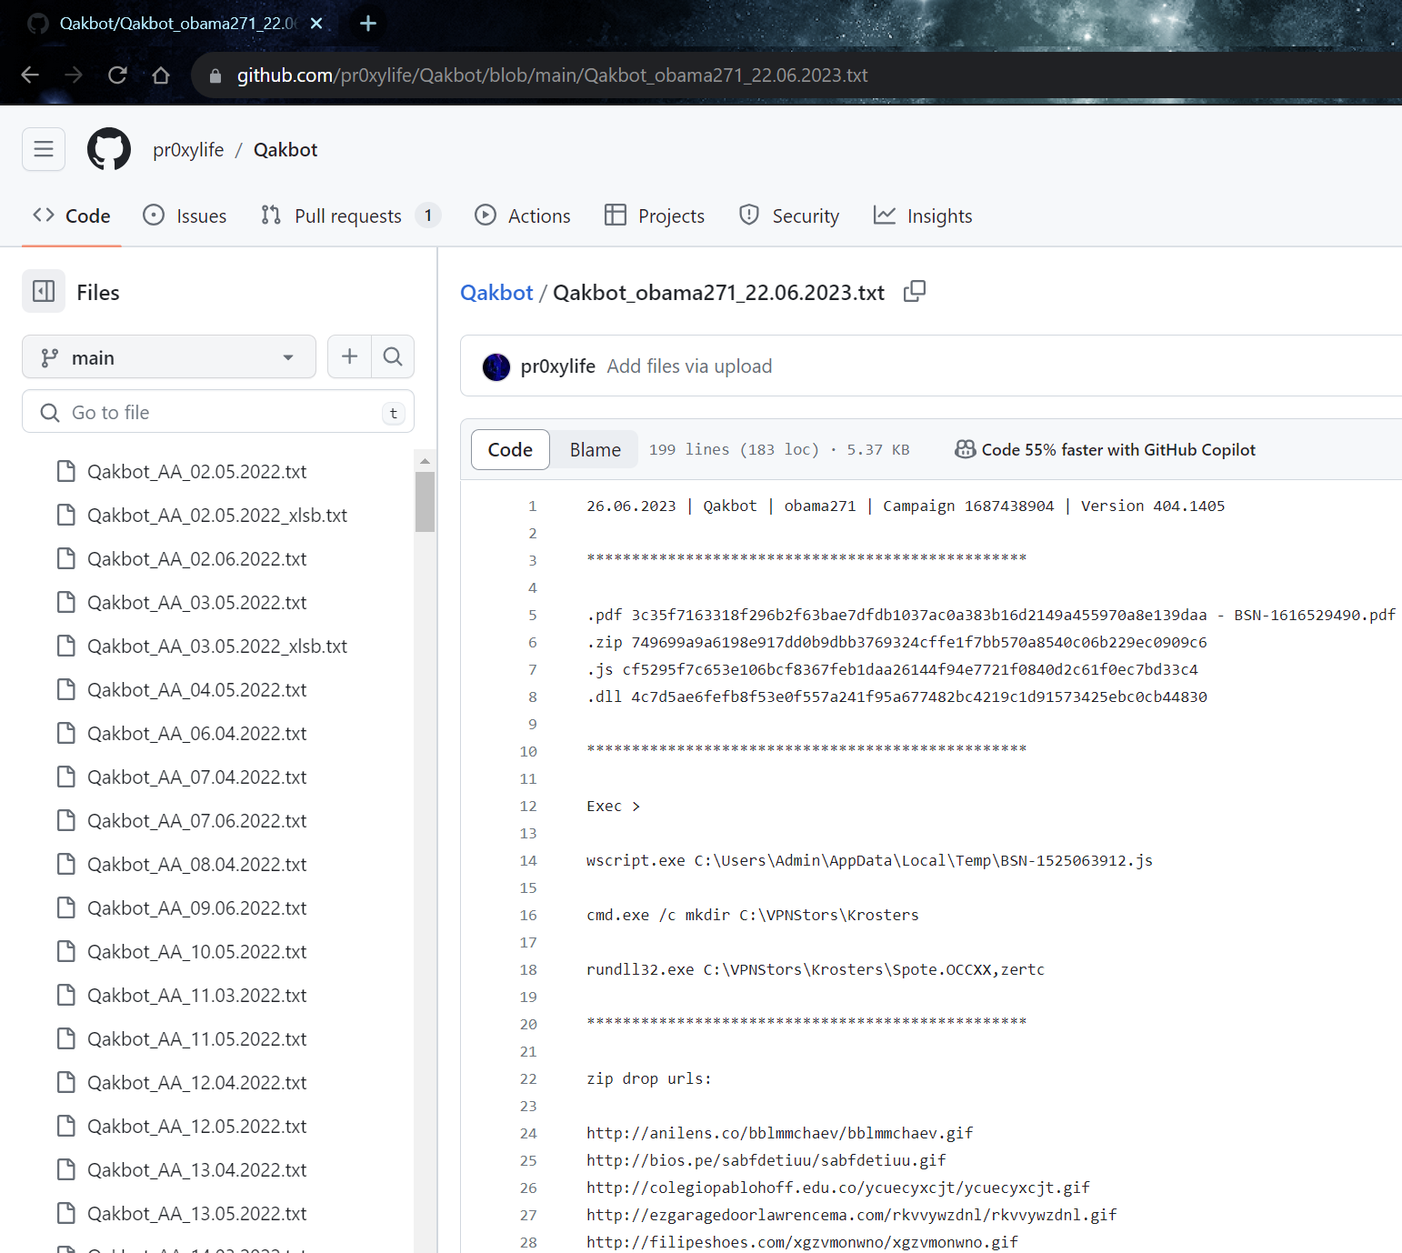
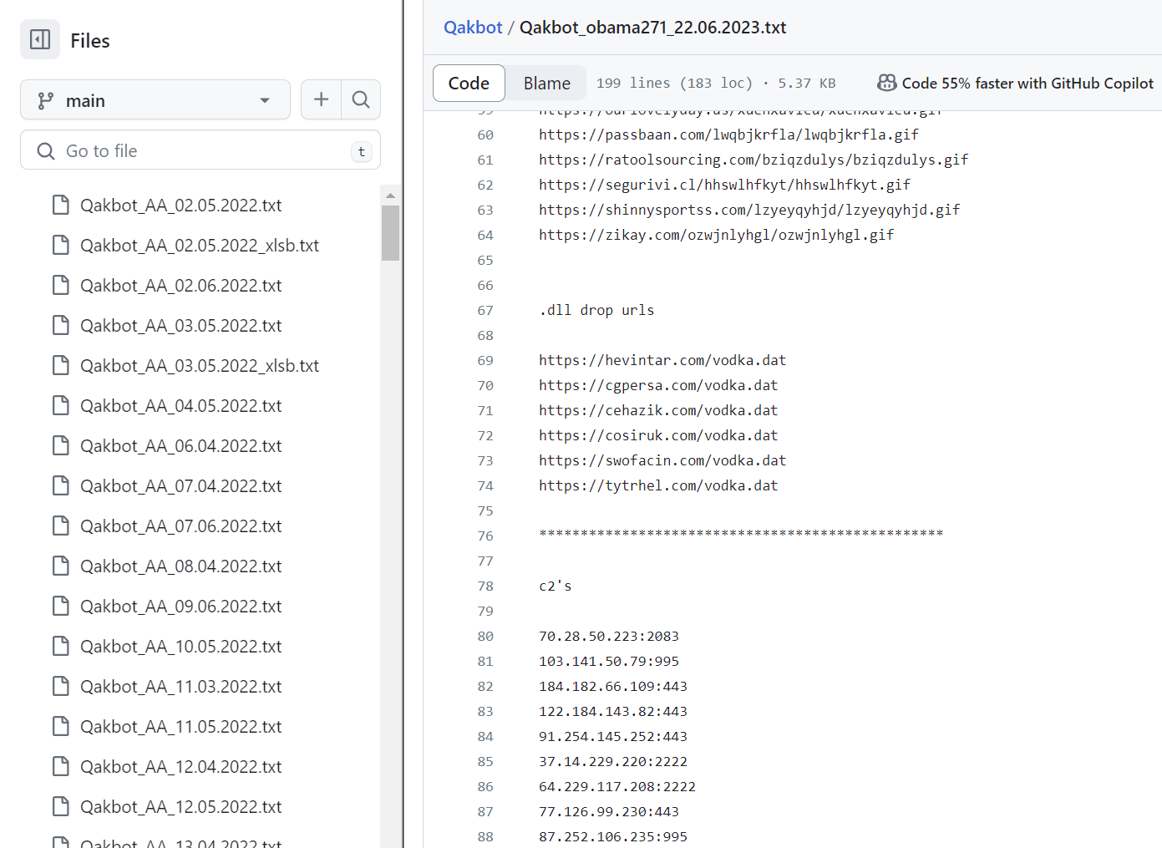
Purple teaming: emulating QakBot
Source: https://github.com/pr0xylife/Qakbot/

Slide 26
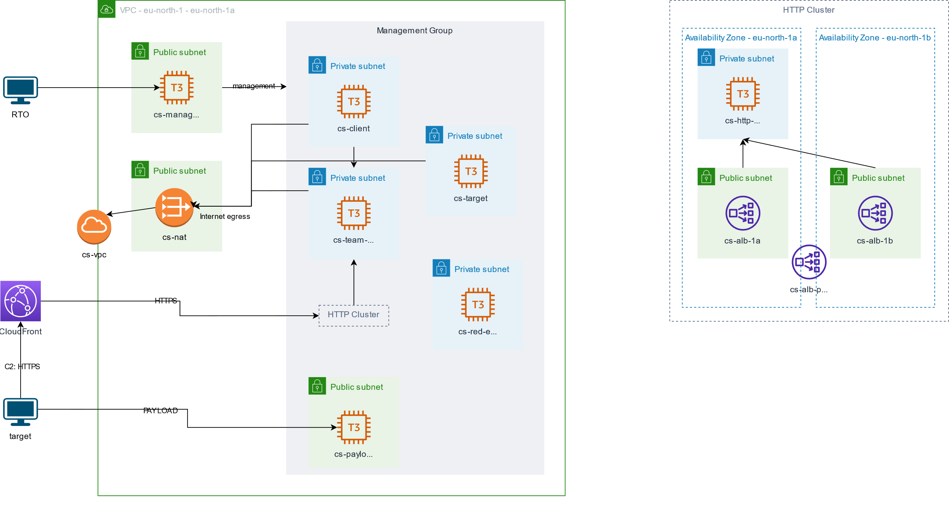
Purple teaming: C2 infrastructure

Slide 27


Slide 28


Physical security: card cloning
Created by Bing image creator: "an angry bird passing turnstile"

Slide 29
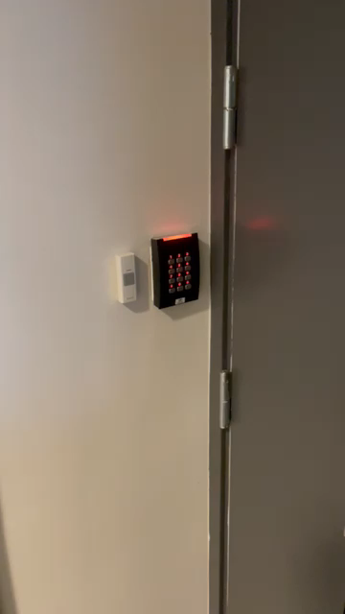
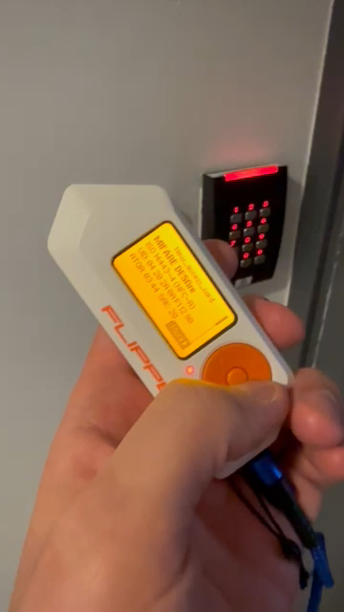

Physical security: card cloning
Created by Bing image creator: "a flipper bypassing door lock"

Slide 30

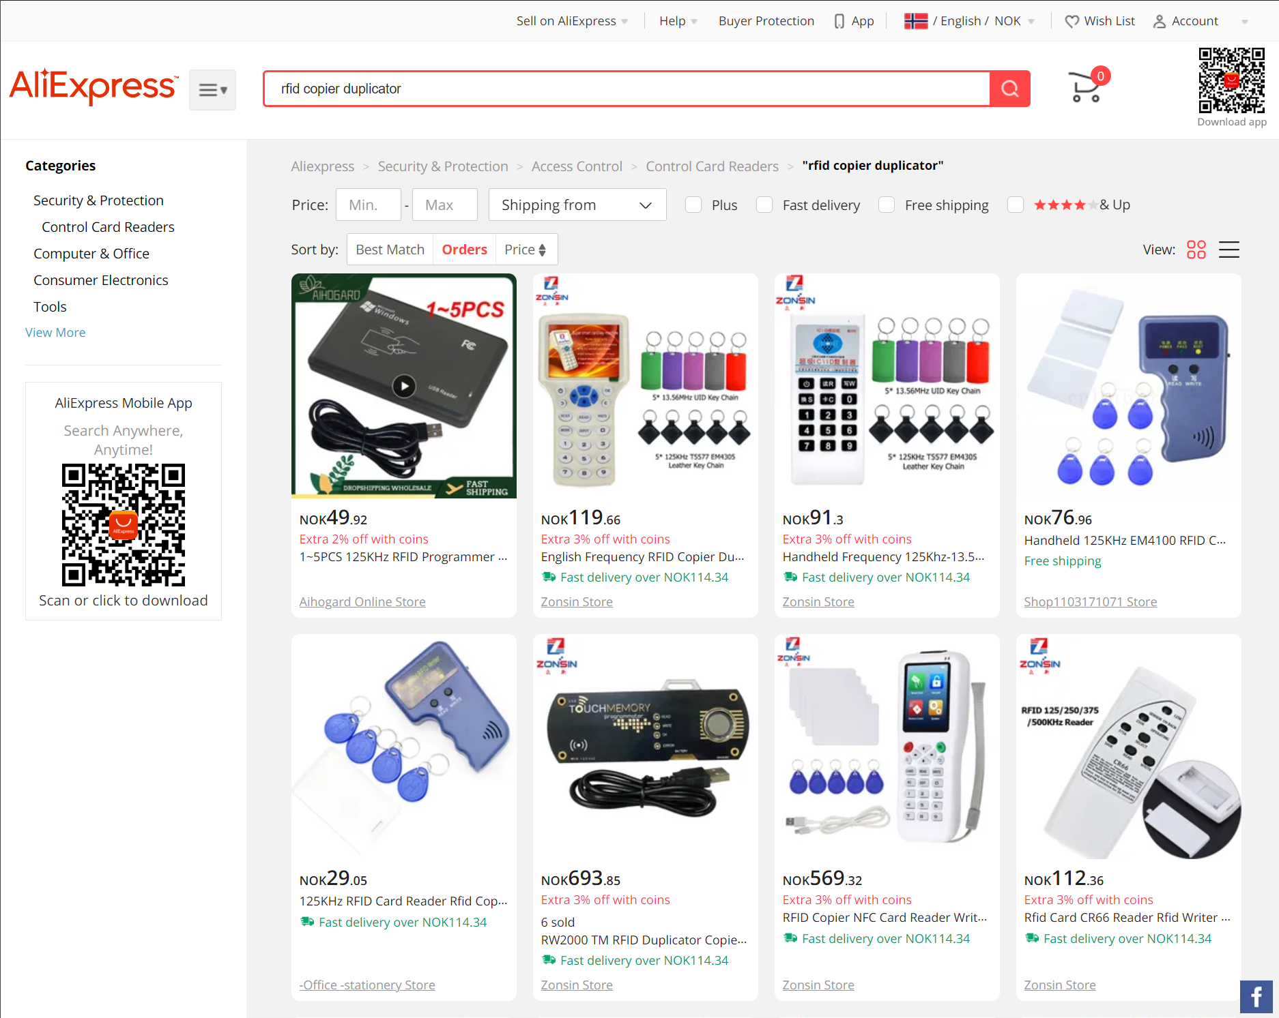
Physical security: card cloning
Cloner
Flipper Zero
Tags

Slide 31
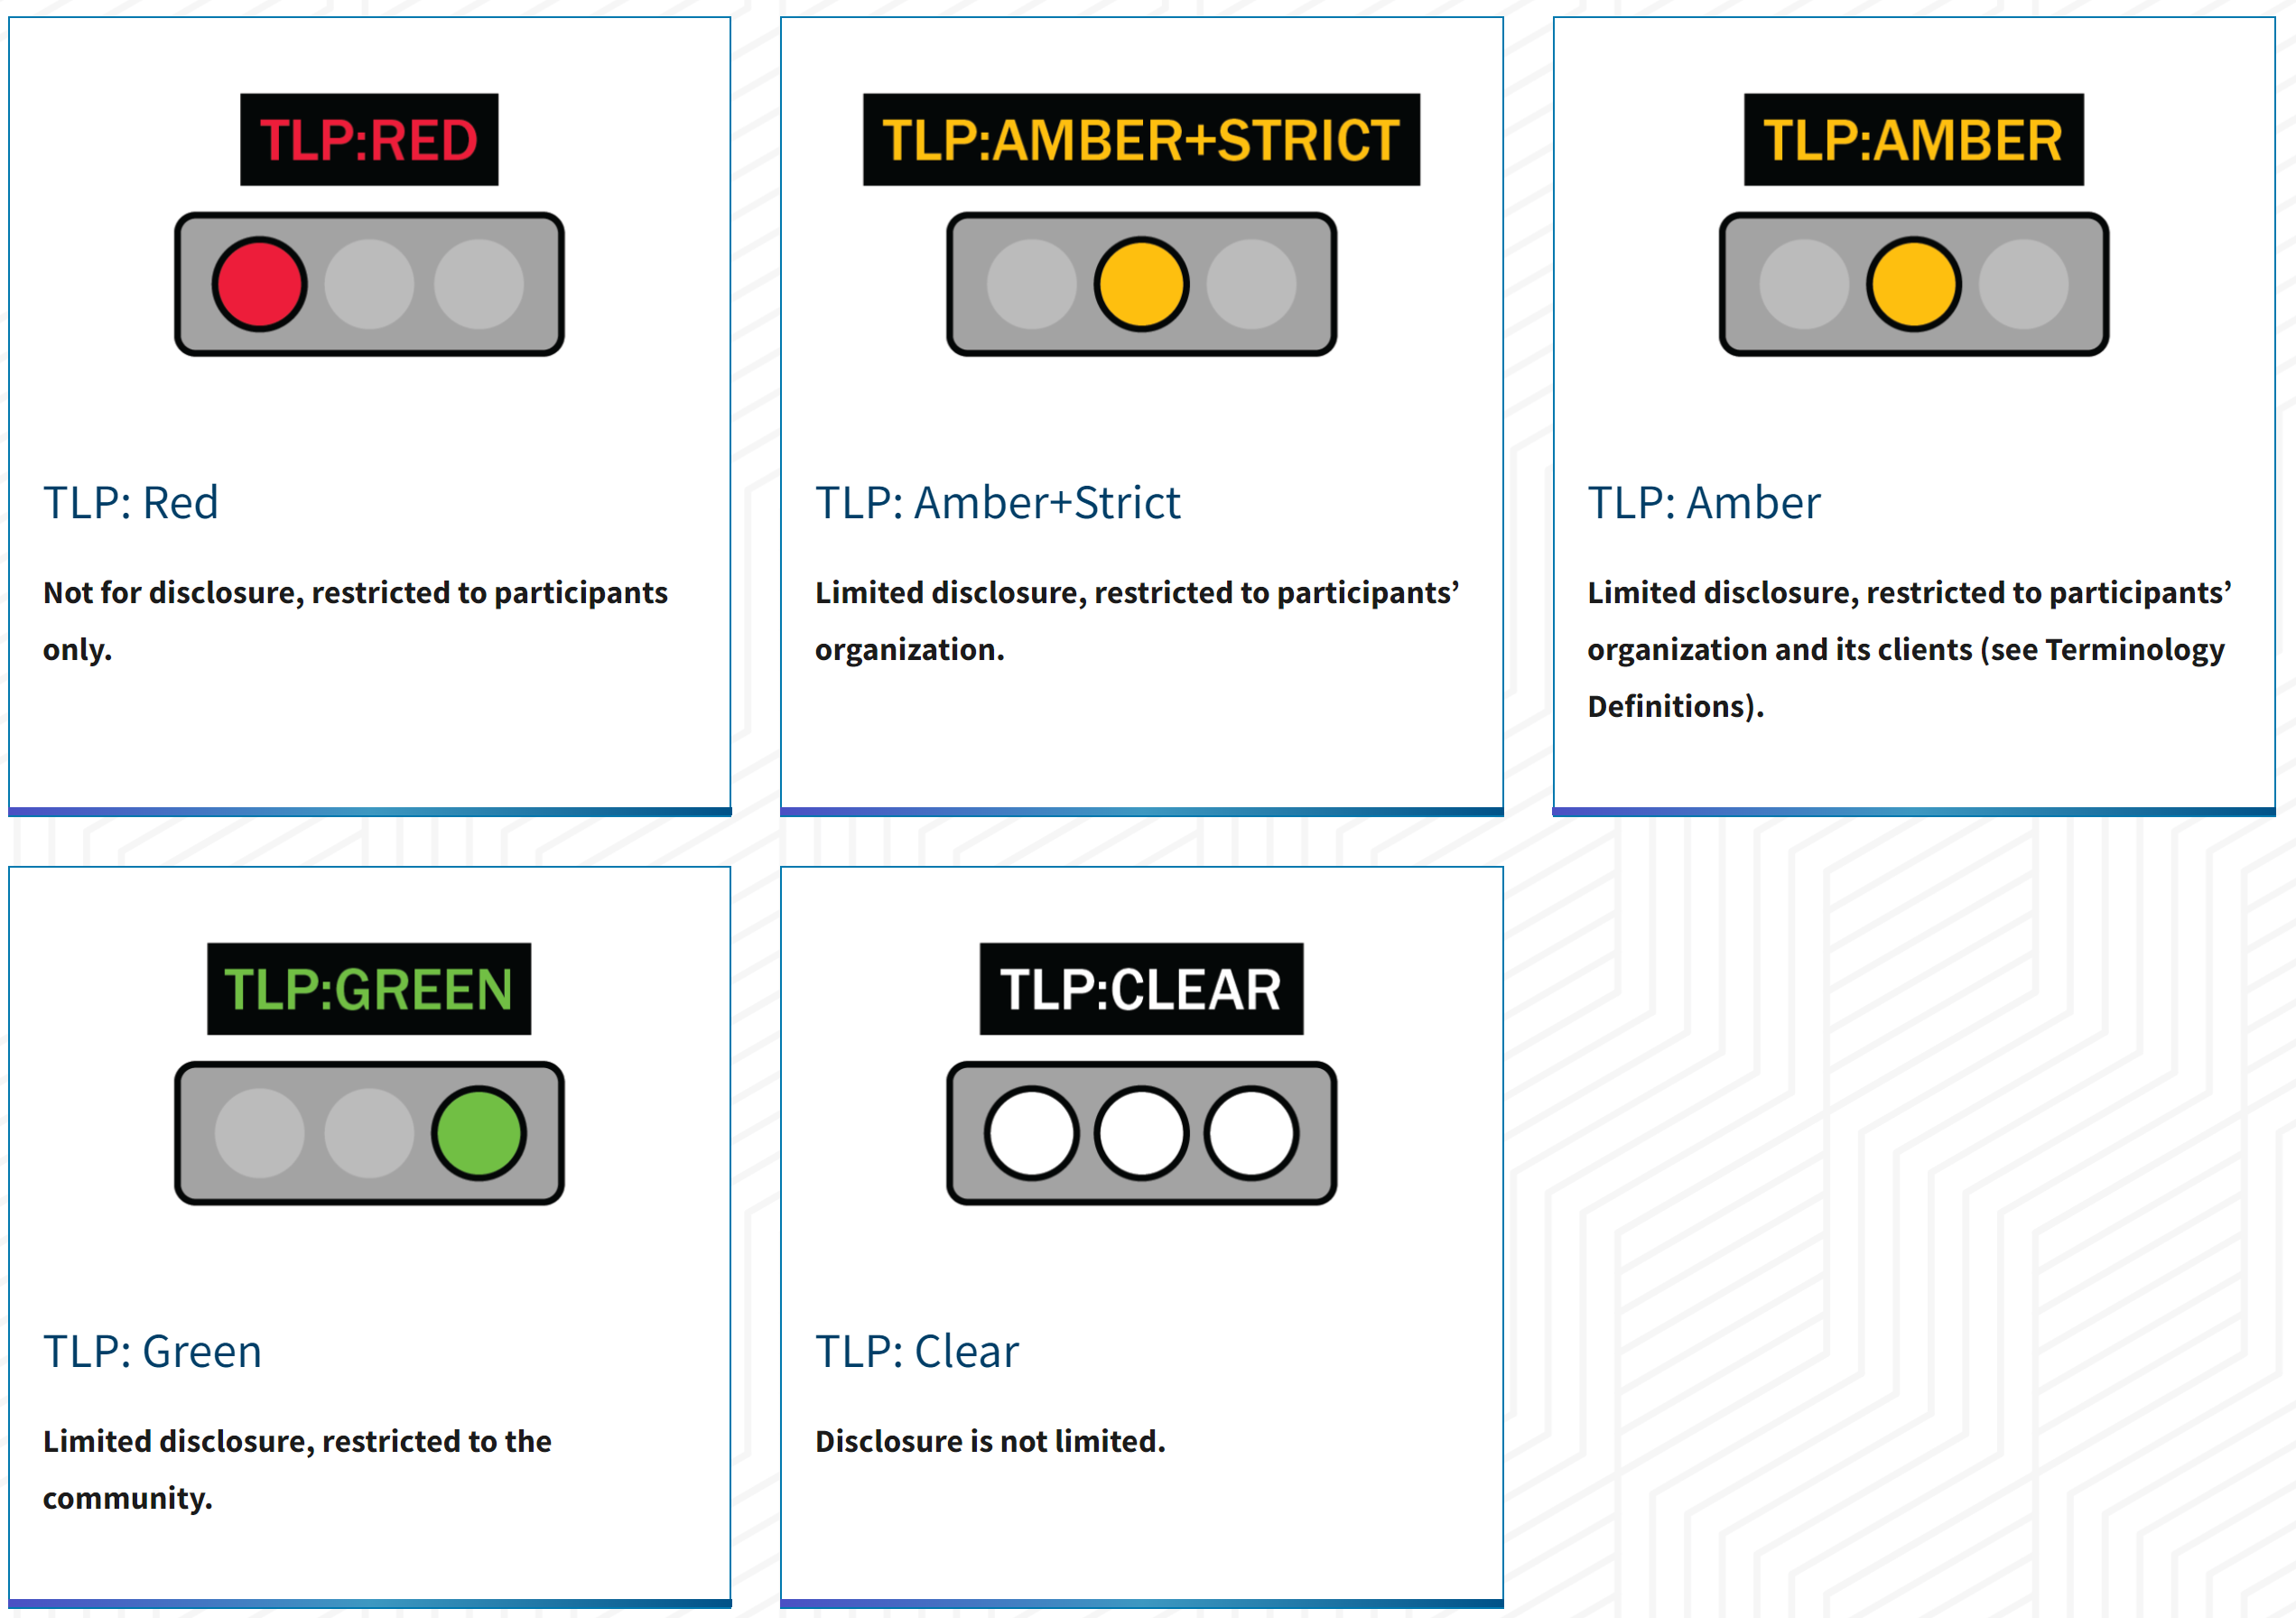
Traffic light protocol (TLP)
Source: Traffic Light Protocol (TLP) Definitions and Usage

Slide 32
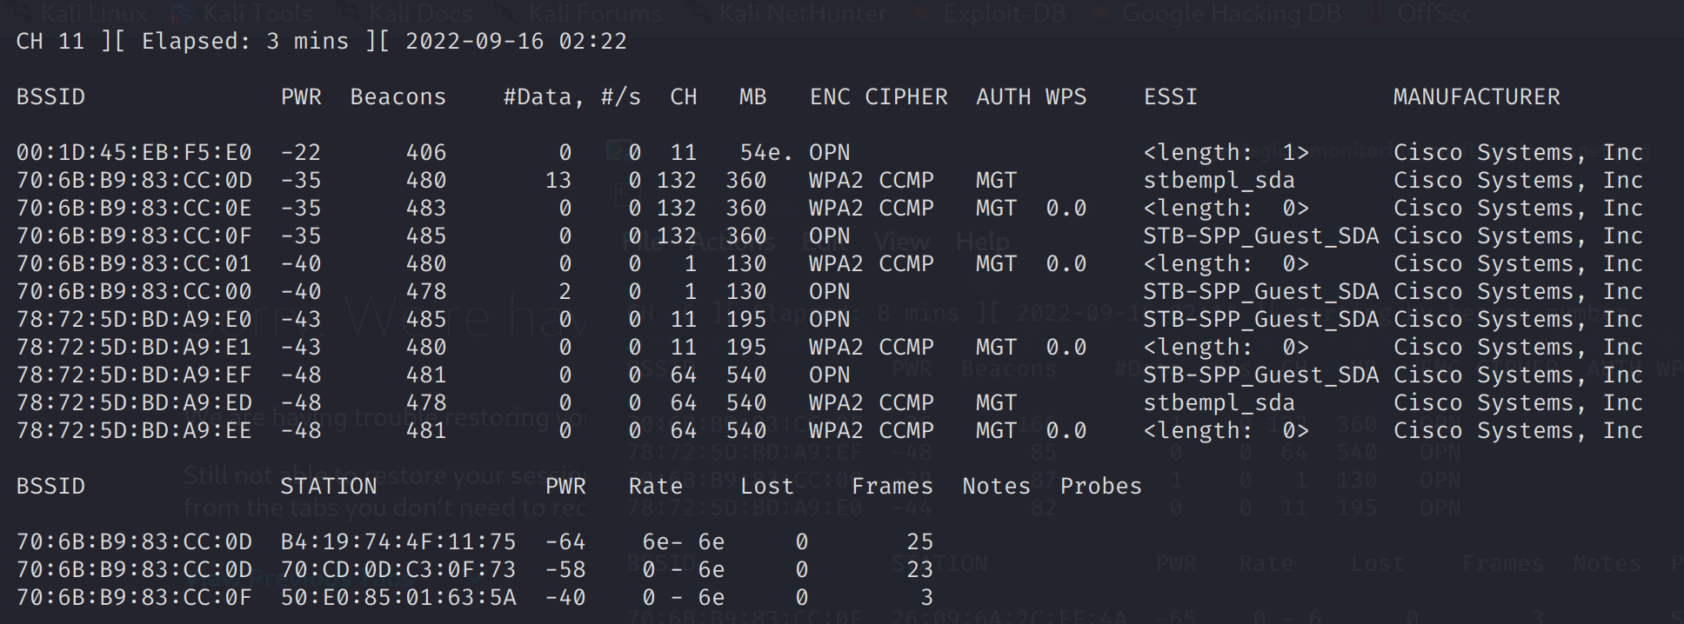
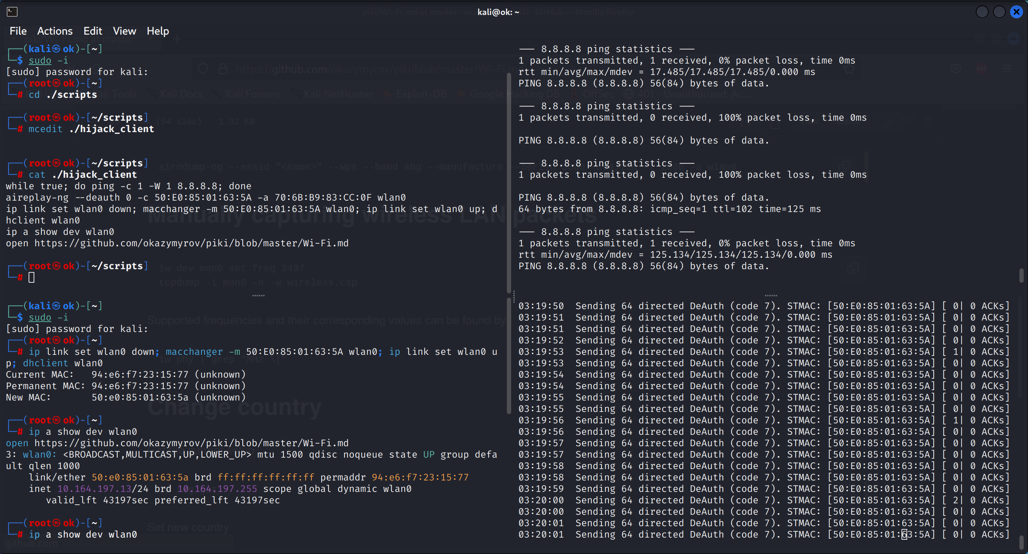
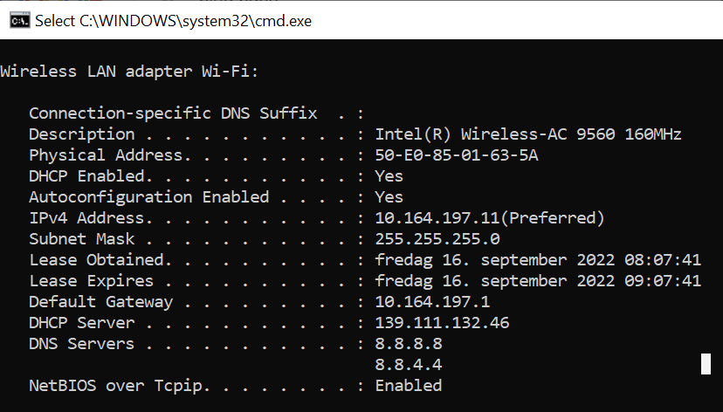
Hijack a client (i.e., spoof MAC address) to bypass authentication on the captive portal
3.1 Continuous ping
1. Find targets by observing Wi-Fi environment (outside, without authentication)
3.2 Wi-Fi deauthentication attack
3.3 Hijacking IP of the authenticated client
2. A target PC with MAC observed in step 1
TLP:RED

Slide 33
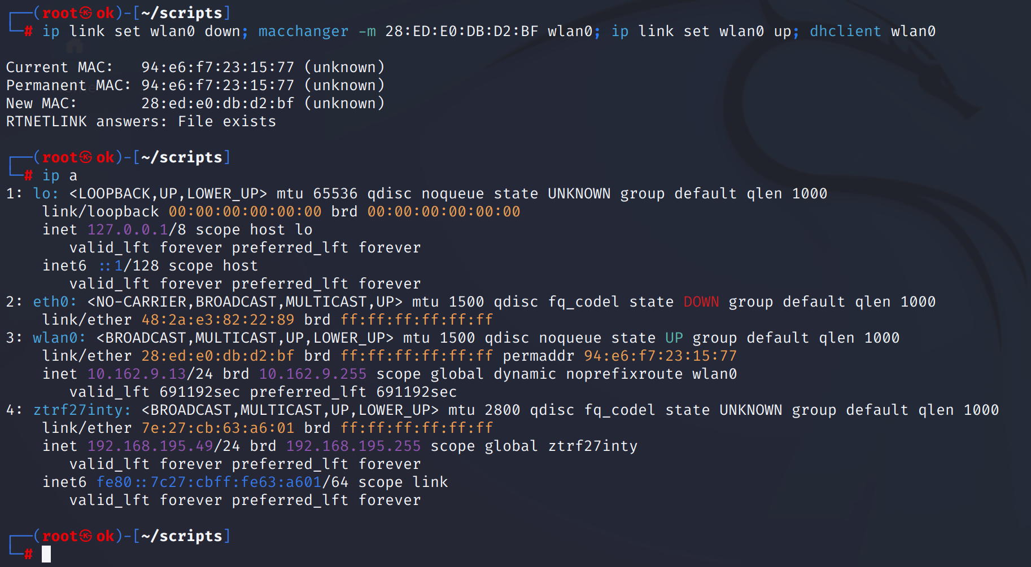
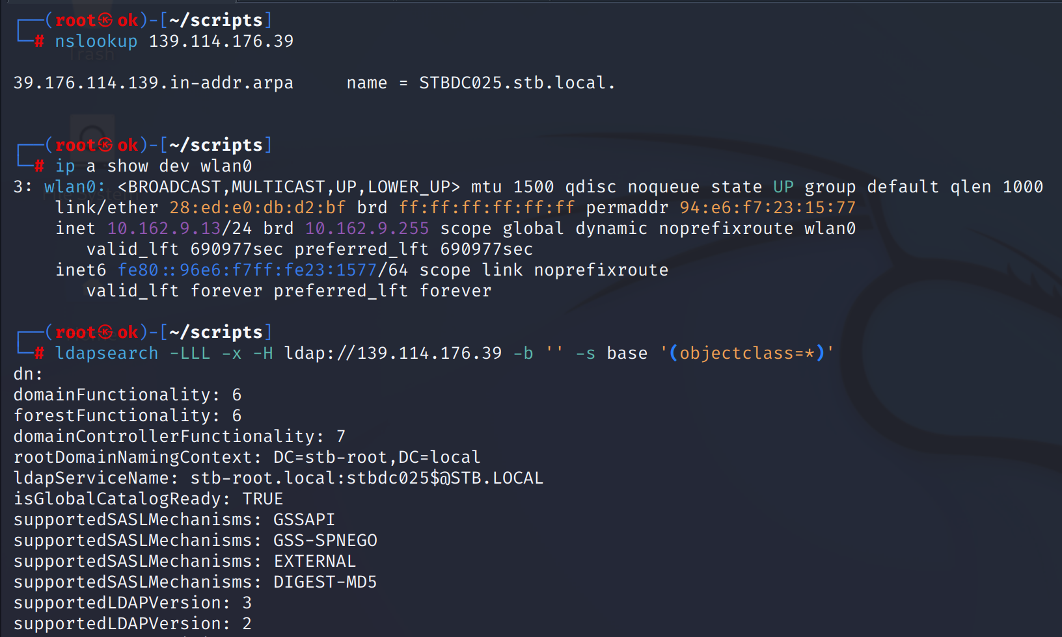
Hijack a trusted/whitelisted devices (i.e., spoof MAC address) to access internal network
1. Change MAC and request IP from DHCP
2. Unauthenticated information gathering on DC/AD
TLP:RED

Slide 34
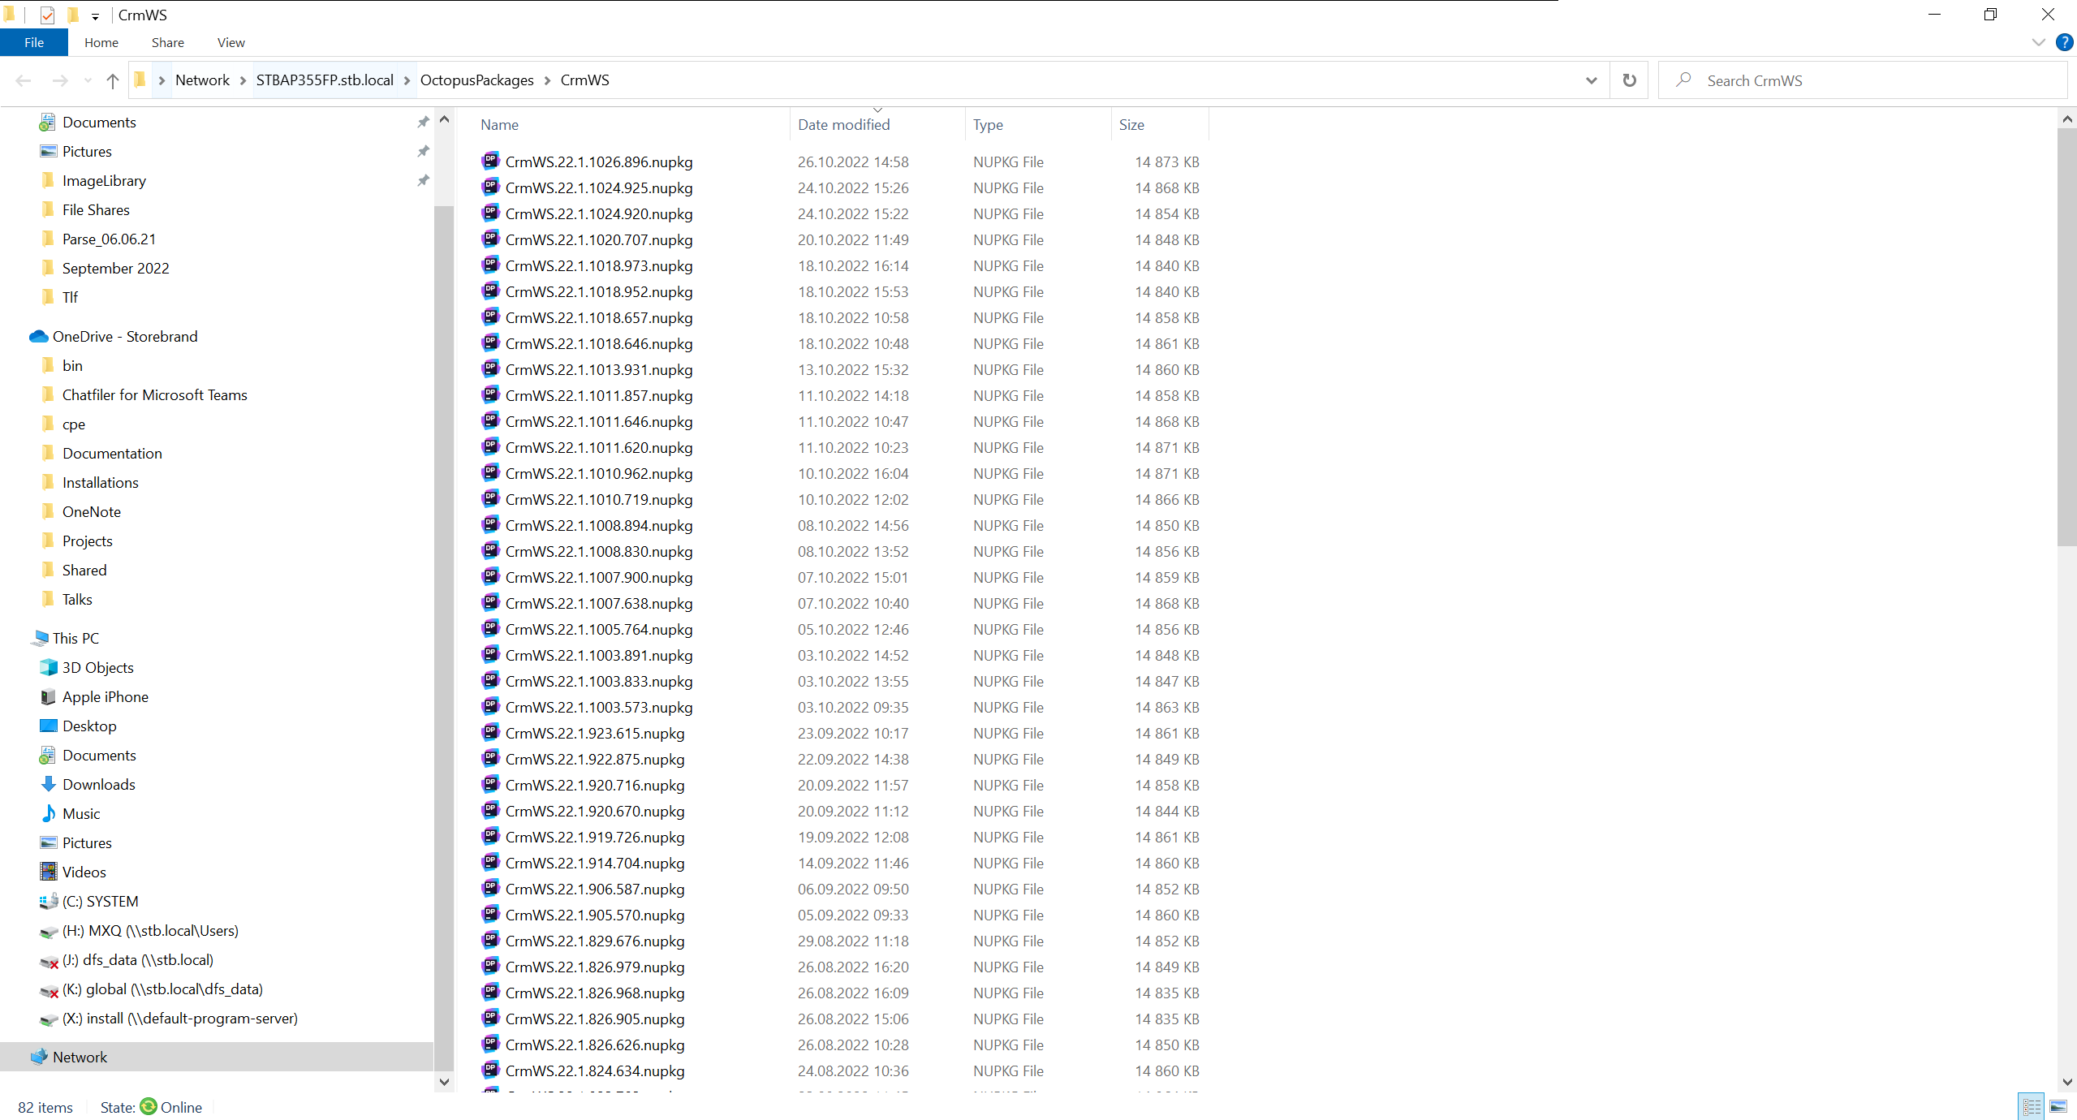
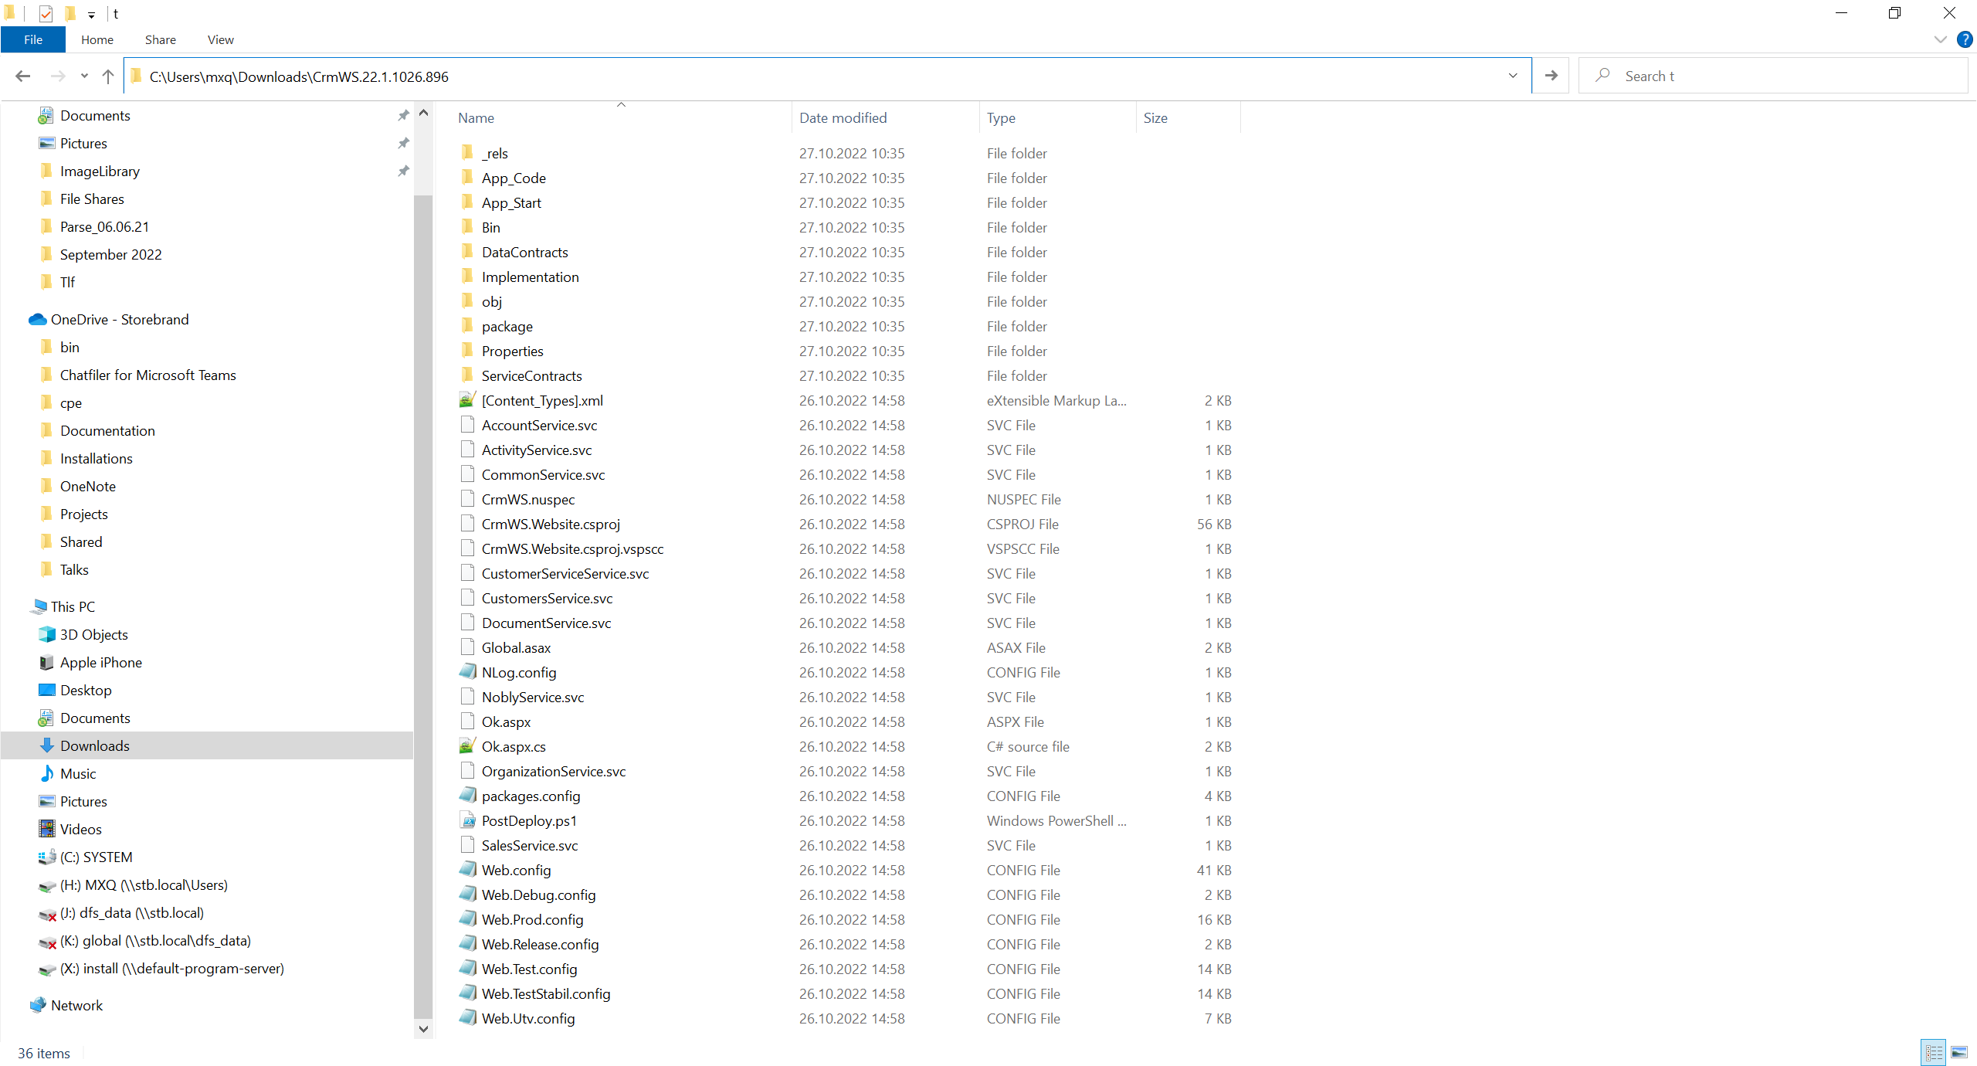
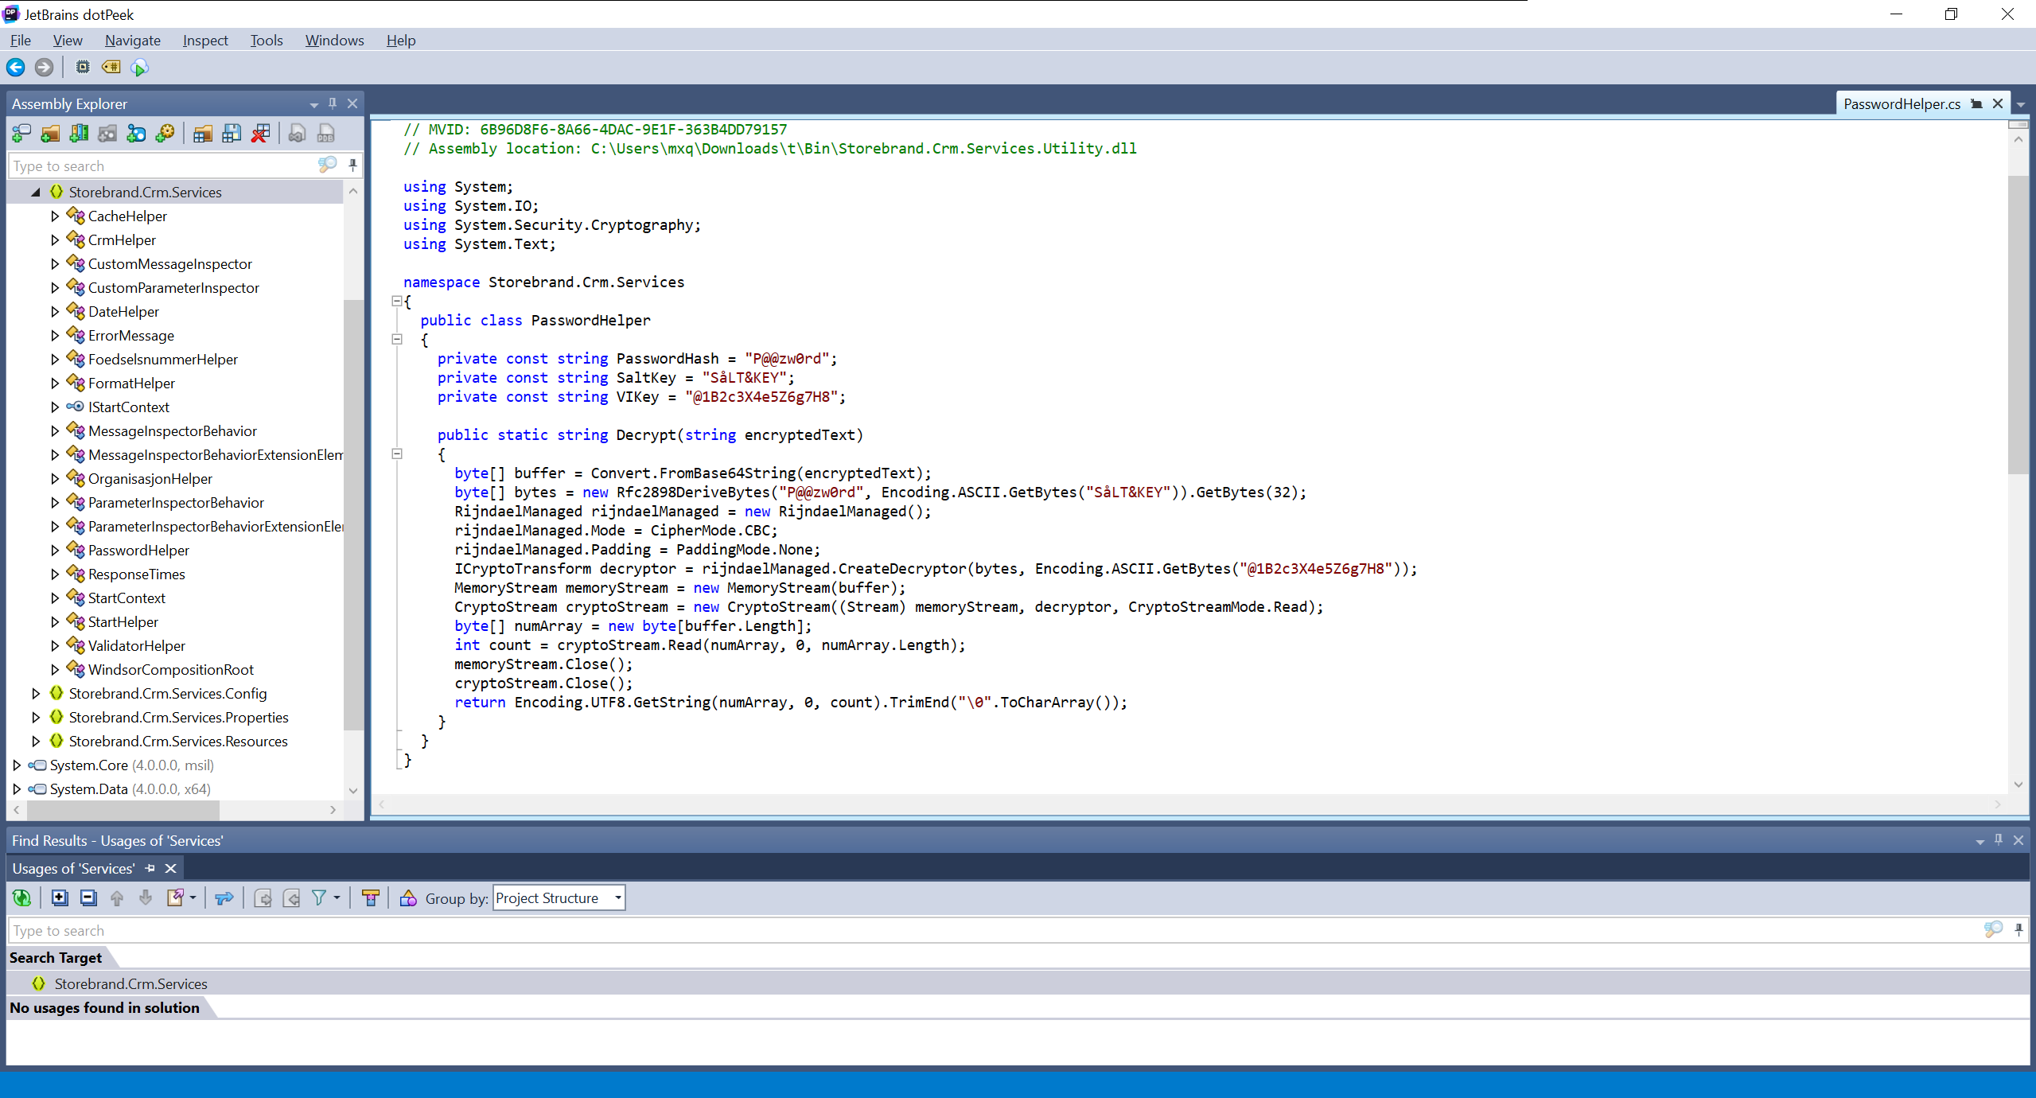
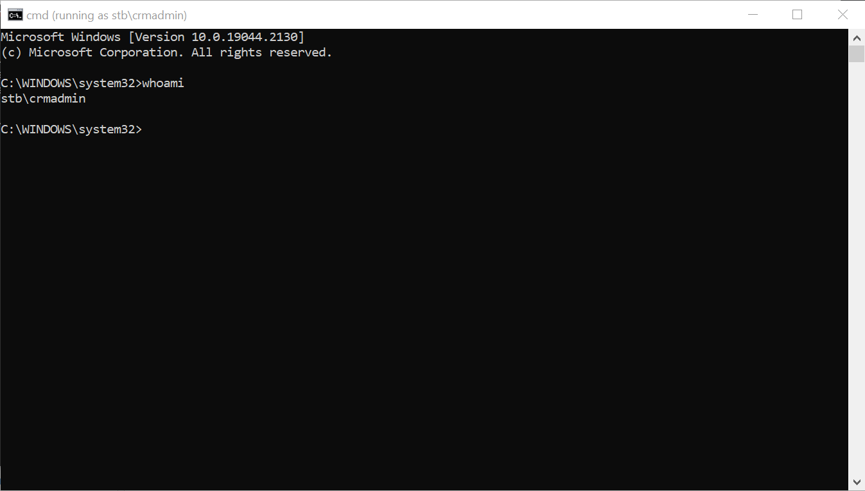
Reverse engineering .nupkg
TLP:RED

Slide 35
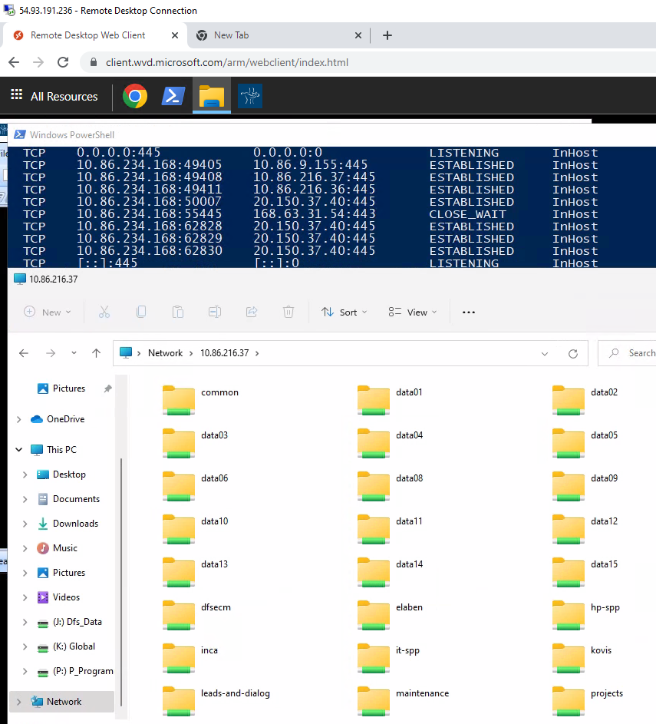
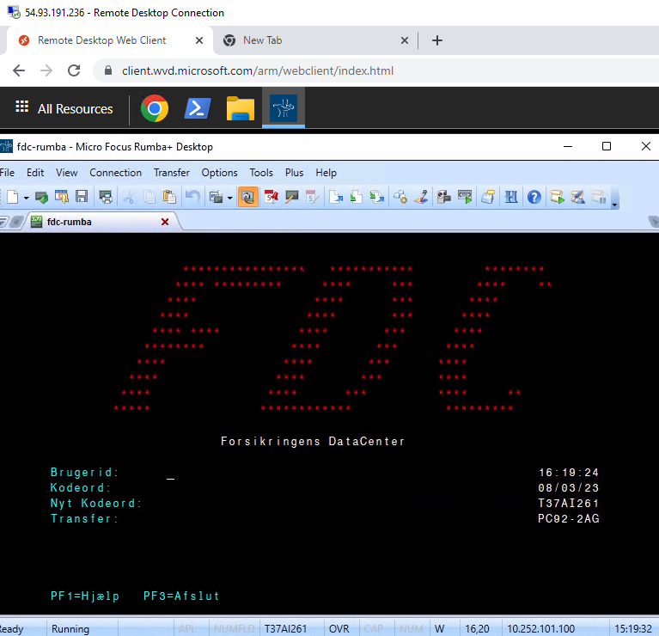
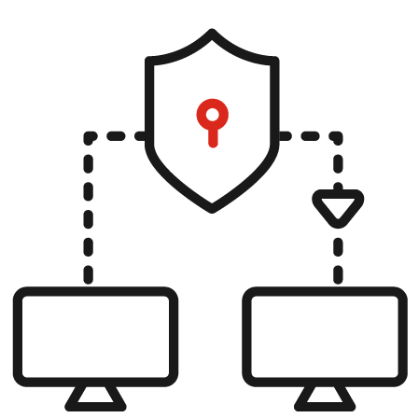
Kill-chain (insurance agents)
4.a The hacker accesses one of many file shares that is widely available and launch a ransomware campaign.
1. A hacker sends an attachment containing malware to one of the insurance agents/partners.
4.a
3.b
4.b
F2100
3b. The hacker may choose to install a backdoor on the AVD and get a separate session.
4.b The hacker steals the session to F2100 and access files through DocsLive or perform unauthorized transactions through Rumba.
2
1
3
3 When the insurance partner accesses the AVD, the hacker hijacks/steal the session.
4.c
4.c The hacker uses the access to potentially spread to other services/systems not related to insurance.
2. An insurance partner opens the attachment, and the malware connects back to the hacker. The hacker now have control of the laptop insurance partners laptop.
TLP:RED

Slide 36
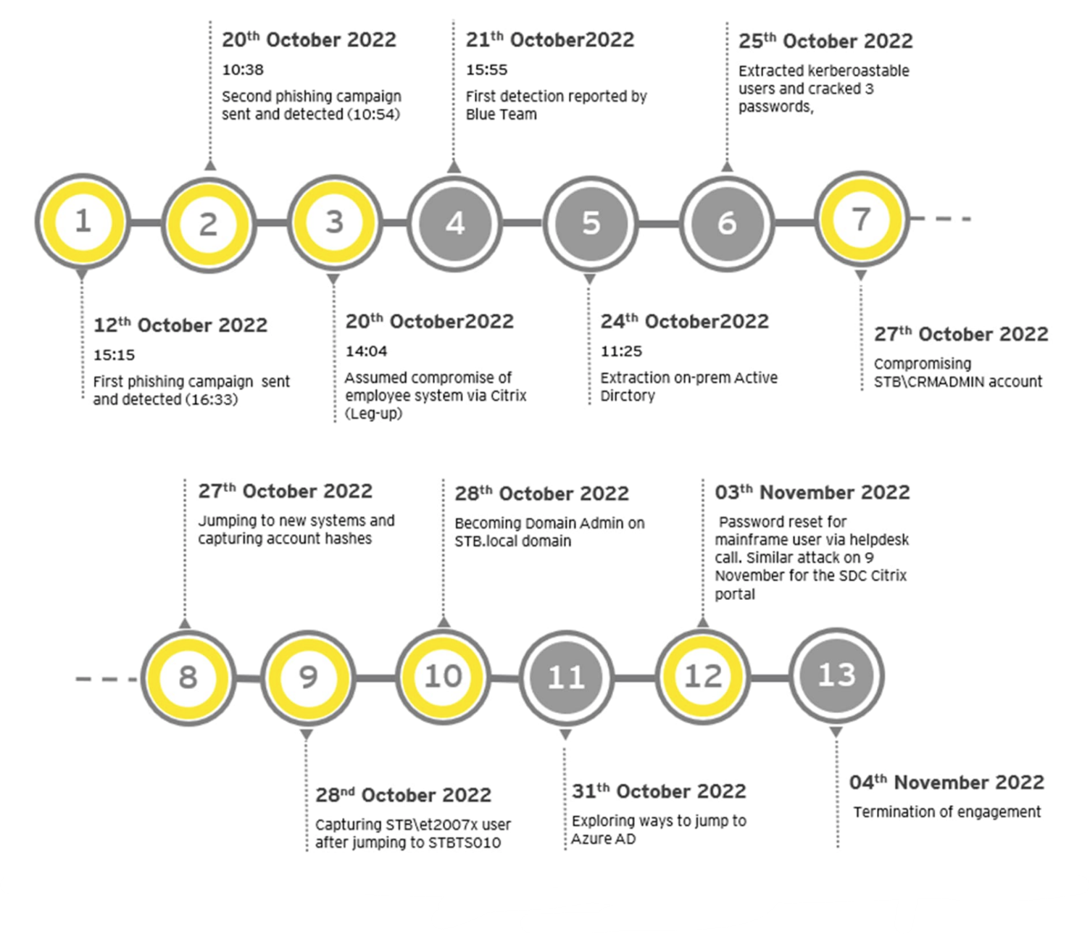
Red teaming exercise Q4 2022

Slide 37




Benefits of having an offensive security team
They can provide critical information and insights during emergencies or incidents.
They can help change the culture of the organization and raise the awareness and skills of the staff.
They can provide cutting-edge solutions and recommendations for mitigating and preventing cyber threats.
They can help validate the effectiveness and efficiency of the existing security controls and policies.

